Slide 1
HME: A Hyperbolic Metric Embedding Approach for Next-POI Recommendation
Rao Xuan
2021-9-27

Slide 2
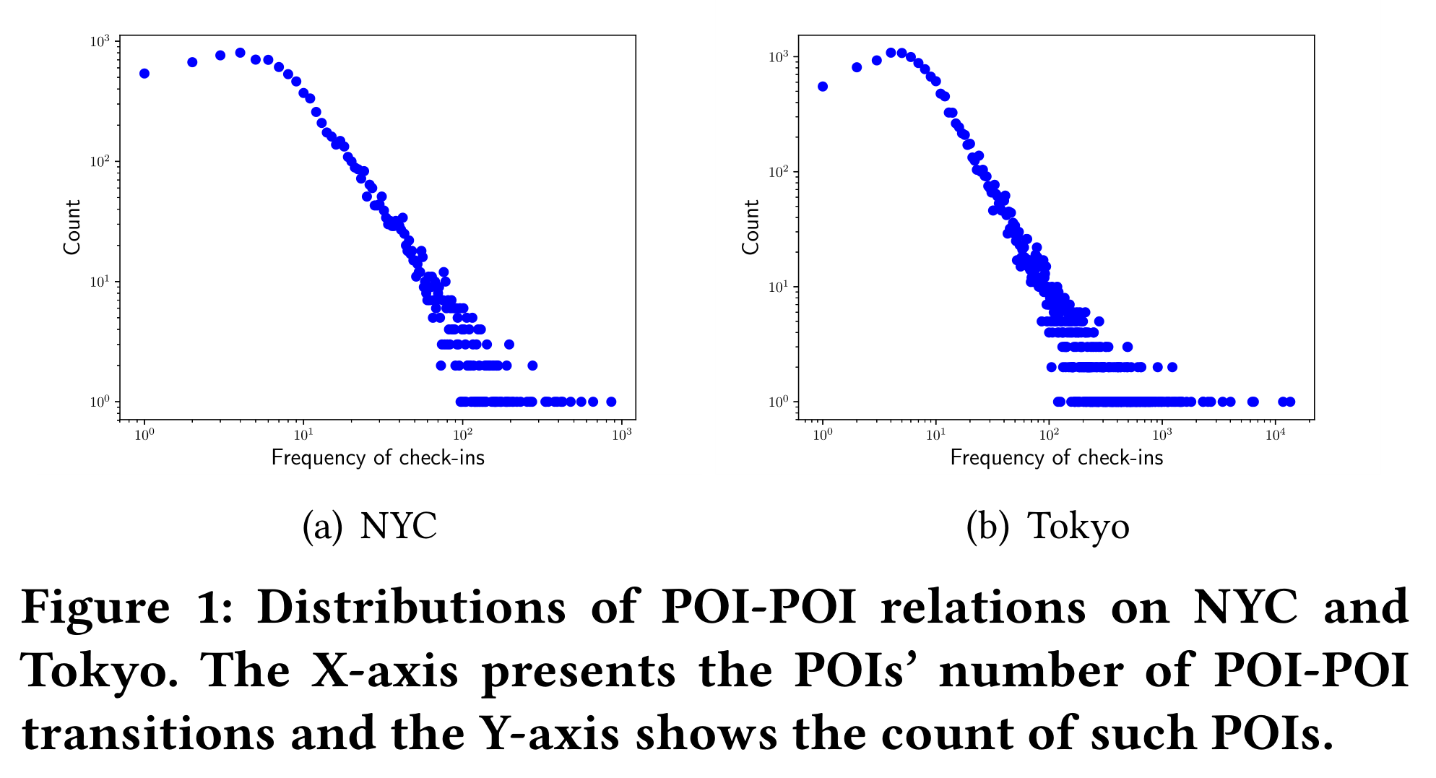
Observation
Some POIs are more likely to be involved in sequential transitions with other POIs, while most POIs are only connected to a small number of POIs.
POI-POI relation(sequential transition)

Slide 3
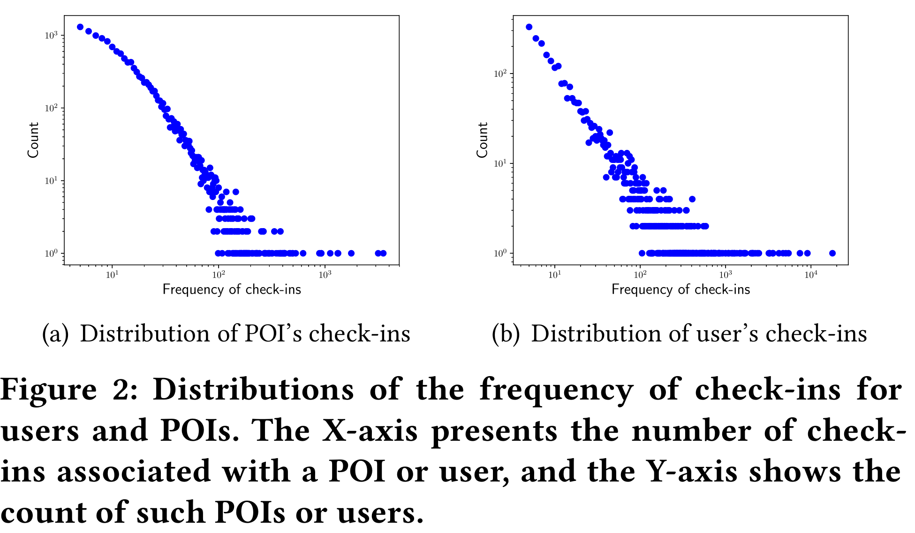
Observation
Some POIs attract many users while the majority of POIs are only visited by a small number of users.
A small portion of users have many check-ins while most of users only have a few check-ins.
POI-User relation(User preference)

Slide 4
Observation
POI-POI relation and POI-User relation follow power-law distributions: a majority of nodes have very few connections, and a few nodes have a huge number of connections.
power-law distributions often indicate implicit hierarchical structures.
Based on the category tree and region tree, we can obtain POI-Category relation and POI-Region relation that reflect the explicit hierarchical structures.
Notes:
The POIs may also exhibit some explicit hierarchical structures, such as the category taxonomy and region hierarchy.
The categories of POIs which can be intuitively organized in a category tree.
POIs can also be hierarchically split into different regions by recursively divide the whole geographical space into sub-regions. In this way, a region tree is constructed.

Slide 5
Innovation
Euclidean embedding models’ capability of learning complex patterns is limited by the dimensionality of the Euclidean space.
The paper aims to learn the representations of check-in activities in a hyperbolic space and proposes a novel hyperbolic metric embedding model based on the Poincaré ball model.
Investigate four kinds of relations: POI-POI, POI-User, POI-Category and POI-Region by projecting then in a shared hyperbolic space.
Notes:
Specifically, there are two main advantages of the hyperbolic space.
First, it can effectively capture the tree structures, as a tree can be approximately viewed as a discrete version of the hyperbolic Space(双曲空间).
Second, it is capable of modeling complex data in a lower-dimensional space.
Poincaré ball model(庞加莱球模型), which is commonly used to describe the hyperbolic space and the distance in the Poincaré ball model is used to reflect the relation between items.

Slide 6
Relations
POI-POI Relation: If the time interval between two consecutive check-ins of a user is smaller than τ = 6 hours, a POI-POI edge exists.
POI-User Relation: If a user u has visited a POI l , there is a POI-User edge.
POI-Region Relation: If a POI is located in a region, there exists an edge between them.
POI-Category Relation: If a POI is associated with a category , there is a POI-Category edge.
Notes:
These extracted POI-POI edges reflect the sequential patterns of user movements.
As different users may have different preferences, personalized interests play an important role in check-in behaviors.
POIs in the same region may have strong relations as users are more likely to visit nearby places.
POIs in a same category share similar intrinsic features.

Slide 7
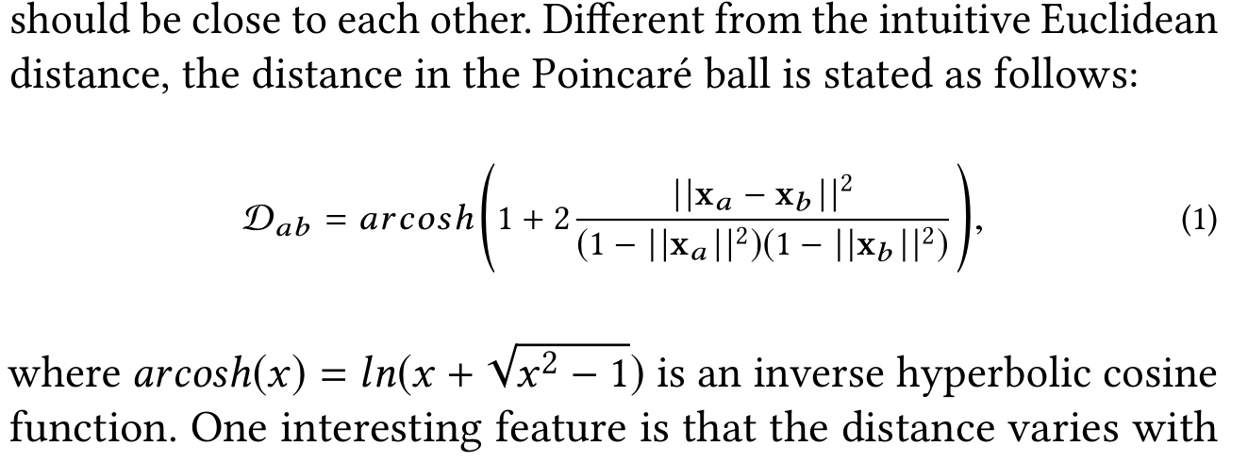
Methodology
Hyperbolic Metric Embedding
The basic idea of hyperbolic metric embedding (HME) is to represent items with the Poincaré ball model, such that the related items are close to each other.
Given an edge < a,b > , the representations x a and x b in the Poincaré ball should be close to each other.

Slide 8
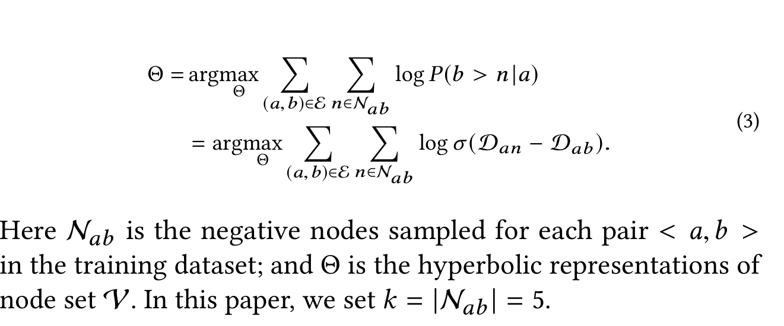
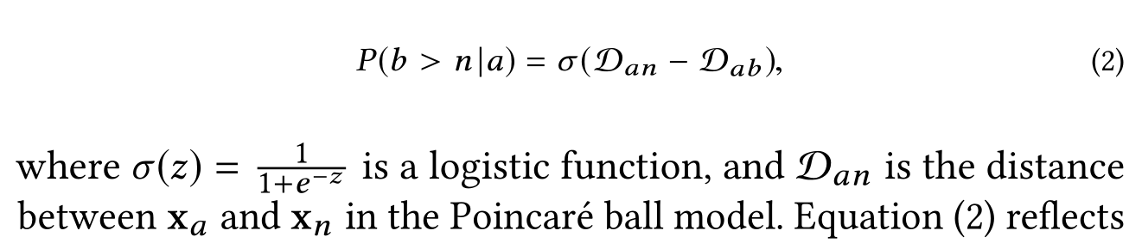
Methodology
Hyperbolic Metric Embedding
Regard an edge <a, b> as positive pair, randomly sample a small number of negative nodes to construct negative pairs.
The distance between a negative pair should be larger than the distance between a positive pair.

Slide 9
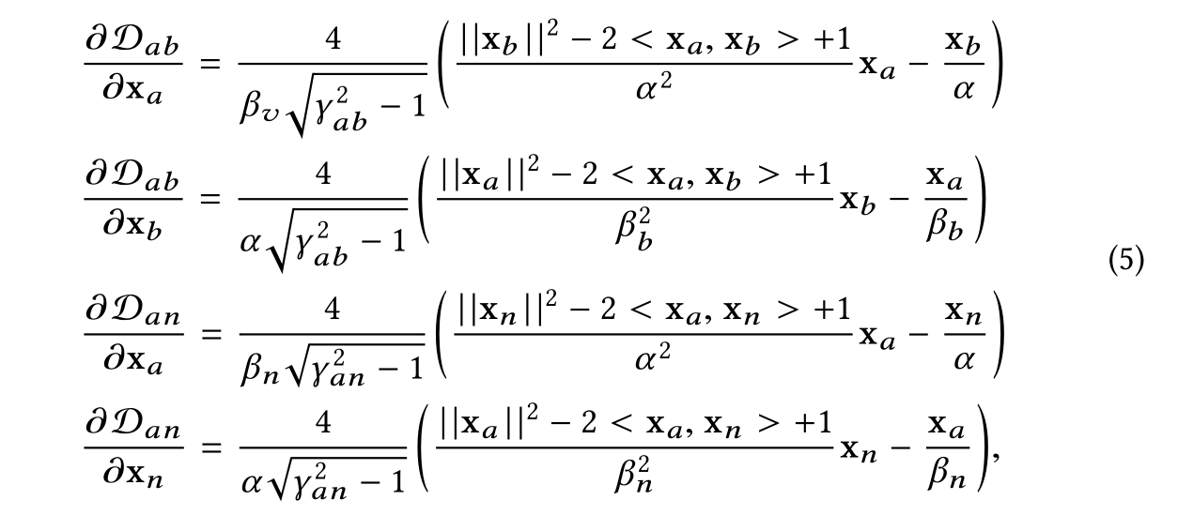
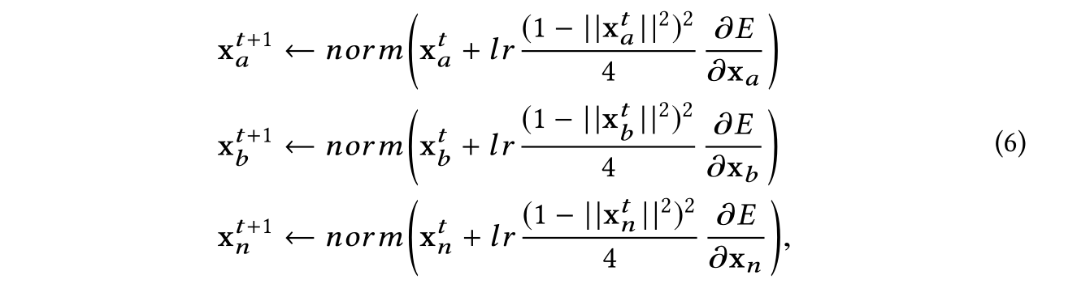
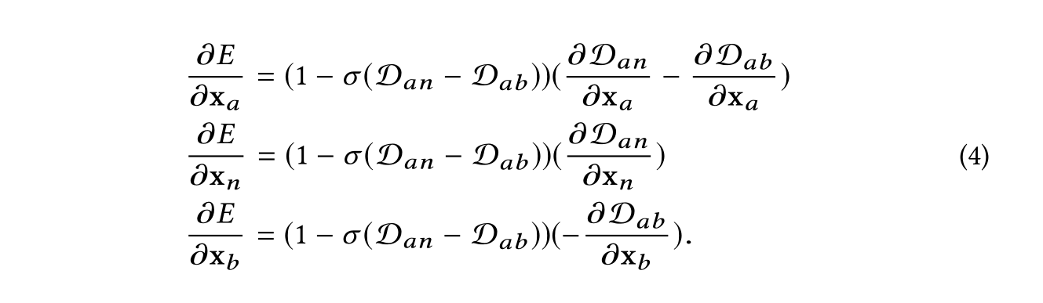
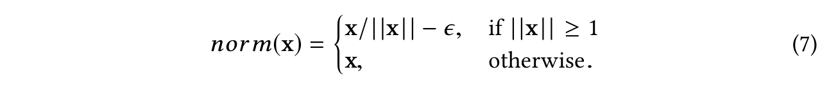
Methodology
Hyperbolic Metric Embedding
Can not directly use the Stochastic Gradient Descent(SGD) due to the Riemannian manifold structure of the Poincaré ball.
First calculate Euclidean gradients and then combine them with the Riemannian gradient to update parameters.
Notes:
Riemannian(黎曼)

Slide 10
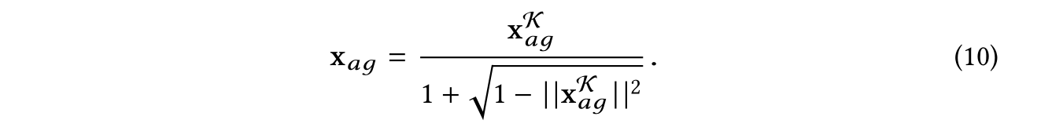
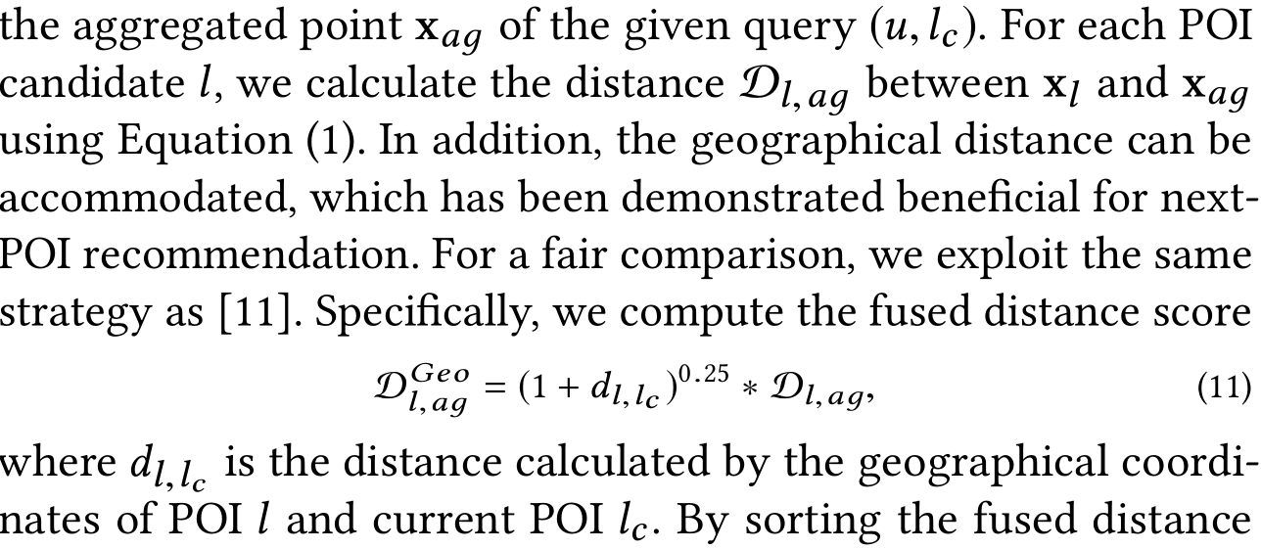

Methodology
Recommending
Due to the hyperbolic geometry, we cannot simply combine the user embedding with the POI embedding by linear interpolation in the Poincaré ball model.
Einstein midpoint aggregation method in the Klein model is used to provides an efficient aggregation operation.
By sorting the fused distance scores of POI candidates, a list of POIs with the smallest fused distance scores are returned as the recommendation result.
Einstein midpoint aggregation
converted into the Poincaré ball model
Convert user embedding and poi embedding to Klein model
Notes:
The Poincaré model and the Klein model(克莱因模型) describe the same hyperbolic space using different coordinates.
Thus, we first convert Poincaré ball coordinates to Klein coordinates, and then calculate the aggregated point. After that, we transfer the Klein coordinates back to the Poincaré ball model.
Einstein(爱因斯坦)

